Slide 1
Consumer Surplus Factor (CSF) study Kraft Heinz – Spoonables 17 January 2025

Slide 2
CSF Introduction

Slide 3
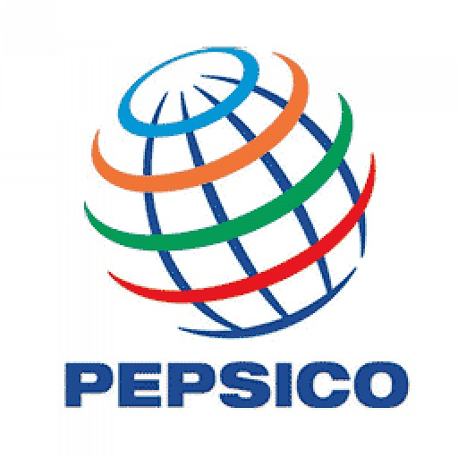





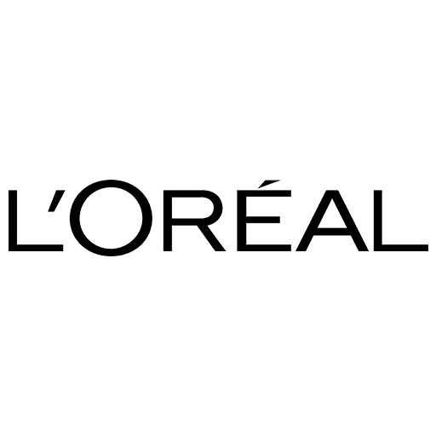




What is Consumer Surplus Factor (CSF)?
CSF is a strategic factor to help brands identify opportunities to further leverage brand equity for pricing and market share growth.
Successfully implemented at
It captures the surplus perceived by a consumer on account of a brand’s equity advantage in a competitive context.
Helps determine pricing power, competitive risks to brand and its market share potential.
CSF also depends on the type of category, macro-economic factors, substitutes, maturity, consumer trends, discretionary nature
< 1.6
1.8 to 2.2
> 2.3
CSF
POOR
HEALTHY
HIGH POTENTIAL
Based on analysis of real consumer behaviour data (Sales)
Developed through research collaboration with academics from Columbia University
Derived from multi-brand econometric analysis to arrive at consumer loyalty

Slide 4






CSF is a measure of value left on the table
How much is a consumer willing to pay Vs. How much are we charging today?
Cohort X
Value perceived (MAX) = $28
Maximum Consumer Value (MCV)
Different cohorts of consumers will perceive different value from brand
Consumer Surplus Factor (CSF) =
Max Consumer value (MCV)
Price to consumer
Cohort 2
Value perceived = $15
Price to consumer
Cohort 1
Value perceived = $8
MCV is a measure of $ value of emotional and functional attributes, perceived by consumer
People whose perceived value from brand is less than price charged will not be consumers
People whose perceived value from brand is more than price charged will be consumers

Slide 5



Brands with higher CSF can lead price increase and/or target higher market share
Brand ABC
is the best!
Can increase price by 12% without risking share loss
Has potential to gain 3% market share
Cohort X
Brand XYZ
is the best!
Will lose share
Will need to reduce price
MCV = $24
Cohort Y
MCV = $16
CSF = 2.4
CSF = 1.6
Price = $10
Price = $10
Strategic price recommendation from this analysis triangulates perceived value, competitive advantage and market share potential
Brands with higher surplus i.e. ratio of max perceived value to price will be in a position to gain market share
Brands with higher surplus can also increase price without risk of losing market share

Slide 6



Objective of a Consumer Surplus Factor (CSF) study
Determine relative competitive advantage and market share headroom at relevant granularity vs competition
Have a long-term planning tool that enables scenario planning basis price modulation
Develop a strategic price index vs critical competitors by brand, segment or channel

Slide 7
Scope of the study
Channel
Food- 66%
Walmart- 31%
Target- 3%
Variant
Mayo- 80%*
Whipped Dressing- 14%
Aioli- 6%
Brand | Food MS % | Walmart MS% | Target MS%
Dukes | 9.9% | 7.6% | 2.8%
Hellmanns Best Foods | 46.2% | 37.4% | 54.4%
Kraft | 9.6% | 14.0% | 10.6%
Mccormick Aioli | 2.0% | 5.4% | -
Miracle Whip | 11.6% | 14.4% | 6.7%
Private Label | 10.2% | 13.0% | 8.1%
Restofcategory | 10.5% | 8.1% | 17.4%
Brand
Jar 8Oz- 1.5%
Jar 15Oz- 9.5%
Jar 30Oz- 51%
Jar 48Oz- 6%
Squeezy 12Oz- 8%
Squeezy 18 To 22Oz- 16%
Others- 8%
PPG
*Mayo includes unflavoured + olive flavoured + avocado flavoured
Percentages are value MS% for 2024 YTD (Jan-Nov)

Slide 8
Reading the results: How to determine if a brand should increase or decrease price?
Price Index is calculated as a ratio of Current Price of Kraft to Weighted Price of all available options within a Channel/Retailer (Food / Walmart / Target)
MCV index is calculated as a ratio of MCV of Kraft divided by Weighted MCV of available options to consumer (Food / Walmart / Target)
MCVs (Max. consumer value) indicates the perceived value provided by each brand and so their ratio is used as a benchmark for the recommended index at which to operate
The degree of difference (+ve or –ve) between Price and MCV Index show whether the price index is more than perceived value or not.
If,
MCV index > Price Index = Pricing power → Can increase price
MCV index < Price Index = Overpriced → Can decrease price
MCV index = Price Index = At parity → Can hold price

Slide 9
Executive Summary

Slide 10
Executive Summary: Key Learnings and Recommendations
Overall CSFs are healthy – implying satisfied consumers with low switching tendency
FOOD Channel
Kraft Mayo has significant interaction with Dukes, but Duke’s is offering a higher CSF
This implies that consumers trading down from Hellmanns and up from PL are more likely to switch to Dukes. So, Kraft needs a price cut to arrest value erosion (Primarily in Jars) and stay at 100 SPI to Dukes.
Kraft Aioli has a relatively stronger MCV and CSF – can command ~10% premium in like-to-like packs.
It should hold the current price to and consider expanding to the cheaper Jar packs.
Miracle whip also has a CSF disadvantage vs competition and needs to cut price (in Jars) and stay at 110 SPI to Dukes to protect share.
WALMART Channel
While overall prices and MCVs are lesser than Food; the drop in Kraft’s MCVs are worse than competition – will need cuts across Jars and Squeezy to protect share and stay at a 95 SPI to Dukes.
TARGET Channel
Here, the higher CSF of premium brands is the main threat; will need to maintain an index of 95 to Dukes

Slide 11
Executive Summary: Kraft Mayo should be indexed to Dukes - 100 SPI in Food, 95 in WM, Target; Miracle whip at 110 SPI to Dukes across channels
FOOD Channel |  | Current |  |  |  |  |  | Do-nothing | Recommendation |  |  | Impact
Brand | Variant | Val. Share | Vol. Share | Price | Price Index to DUKES | MCV Index to DUKES | Value Market Share Potential (MSP) | Vol. Share in Do-nothing sceario | Price Movement Reco. | Price Reco. | New Index to DUKES | Price diff % | Change in Vol. Share (Vs do-nothing)
Kraft | Mayo | 8.9% | 9.4% | 3.28 | 110 | 101 | -0.32% | 9.1% | Cut | 3.02 | 101 | -7.9% | 0.9%
 | Aioli | 0.7% | 0.4% | 6.04 | 203 | 198 | 0.00% | 0.4% | Maintain | 6.04 | 203 | 0.0% | 0.0%
Miracle Whip | WD | 11.6% | 11.0% | 3.64 | 122 | 110 | -0.57% | 10.5% | Cut | 3.30 | 111 | -9.4% | 1.4%
Portfolio Impact |  |  | 20.8% |  |  |  | -0.89% | 20.0% |  |  |  |  | 2.3%
WALMART Channel
Kraft | Mayo | 13.0% | 13.6% | 2.90 | 104 | 93 | -0.53% | 13.0% | Cut | 2.67 | 96 | -7.8% | 1.2%
 | Aioli | 1.0% | 0.5% | 5.53 | 199 | 203 | 0.04% | 0.6% | Maintain | 5.53 | 199 | -0.1% | -0.1%
Miracle Whip | WD | 14.4% | 13.0% | 3.36 | 121 | 106 | -0.78% | 12.3% | Cut | 2.97 | 107 | -11.5% | 1.9%
Portfolio Impact |  |  | 27.1% |  |  |  | -1.27% | 25.9% |  |  |  |  | 3.0%
TARGET Channel
Kraft | Mayo | 6.7% | 8.7% | 3.13 | 98 | 95 | -0.27% | 8.4% | Cut | 2.94 | 93 | -6.1% | 0.7%
 | Aioli | 3.9% | 2.7% | 5.76 | 180 | 196 | 0.15% | 2.9% | Maintain | 5.76 | 180 | 0.0% | 0.0%
Miracle Whip | WD | 6.7% | 7.2% | 3.75 | 117 | 116 | -0.19% | 7.0% | Cut | 3.62 | 113 | -3.5% | 0.3%
Portfolio Impact |  |  | 18.6% |  |  |  | -0.31% | 18.3% |  |  |  |  | 1.0%

Slide 12
Food

Slide 13
Variant x Brand -Food Channel - Market Context (Dec’23 to Nov’24 vs P12M )
Summary of change in market share and price across brands and variants
Brand | Val. MS % | MS% Change | Avg Price | Price% Change
Dukes | 9.9% | 1.2% | 2.98 | 0.2%
Hellmanns | 46.2% | 0.0% | 3.70 | 3.9%
Kraft | 9.6% | -1.2% | 3.39 | 2.7%
Mccormick Aioli | 2.0% | 0.2% | 4.59 | 2.6%
Miracle Whip | 11.6% | -0.9% | 3.64 | 0.7%
Private Label | 10.2% | 0.2% | 2.32 | 0.3%
Restofcategory | 10.5% | 0.6% | 4.47 | 2.4%
Sales through Food : 66% Change in Category :
Value = +3.9%
Volume = +1.7%
Price = +2.2%
Food channel has grown in value, volume and price
Except Kraft and Miracle Whip, all the brands have either grown or are stable
At a variant level, Whipped Dressing has lost volume and value share to both Mayo and Aioli
While Mayo is growing, Kraft is losing maximum share here
Kraft is stable in Aioli
Brand Variant | Val. MS% | MS% Change | Avg Price | Price% Change
Mayo | 81.7% | 0.5% | 3.35 | 2.2%
Dukes | 9.9% | 1.3% | 2.98 | 0.3%
Hellmanns | 45.6% | -0.2% | 3.68 | 3.7%
Kraft | 8.9% | -1.3% | 3.28 | 1.6%
Private Label | 10.1% | 0.2% | 2.31 | 0.2%
Restofcategory | 7.3% | 0.7% | 4.43 | 1.4%
Whipped Dressing | 13.1% | -1.0% | 3.56 | 1.0%
Miracle Whip | 11.6% | -0.9% | 3.64 | 0.7%
Restofcategory | 1.4% | -0.1% | 3.02 | 3.1%
Aioli | 5.2% | 0.4% | 5.75 | 3.8%
Dukes | 0.1% | 0.0% | 3.14 | -5.5%
Hellmanns | 0.6% | 0.2% | 6.47 | 5.0%
Kraft | 0.7% | 0.1% | 6.04 | 6.4%
Mccormick Aioli | 2.0% | 0.2% | 4.59 | 2.6%
Private Label | 0.1% | 0.0% | 4.85 | 23.1%
Restofcategory | 1.7% | 0.0% | 7.94 | 5.0%

Slide 14
Food: Although KHC brands’ CSFs are healthy at ~2, competition CSFS are higher at ~2.2
In mayo, Kraft faces challenge Dukes in the mid-tier price segment
Mayo- 74.4%
Whipped Dressing (WD)- 11.6%
Aioli- 3.2%
MCV
CSF
Price
C.MS
9.9% | 45.6% | 8.9% | 10.1% |  | 11.6% |  | 0.6% | 0.7% | 2.0%
0.20% | 0.37% | -0.32% | 0.17% |  | -0.57% |  | 0.02% | 0.00% | -0.04%
MSP
Dukes has better CSF and comparable MCV at a price lower than in Kraft in Mayo. Kraft has risk of losing consumers to Dukes (if consumers are downgrading) and to Hellmanns (if consumers are upgrading)
Miracle Whip has a CSF disadvantage as well and hence need to cut price in order to protect MS%
Kraft is stronger in aioli and can maintain its current price

Slide 15
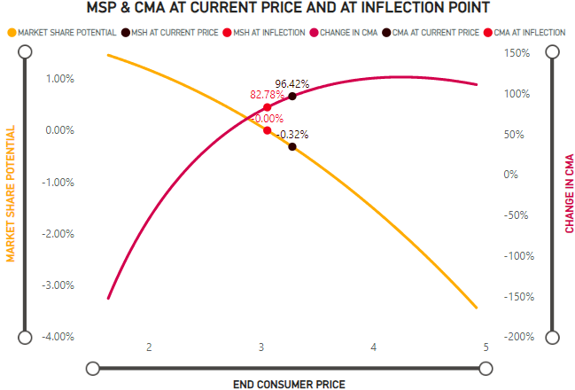
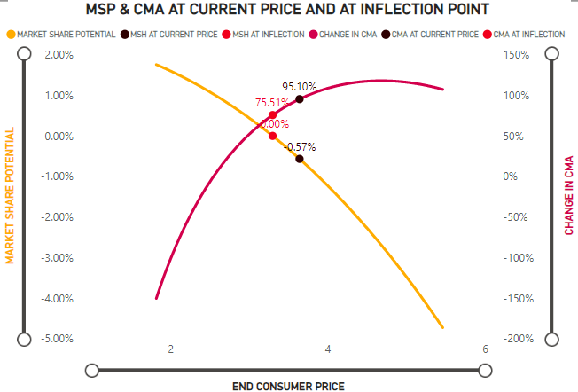
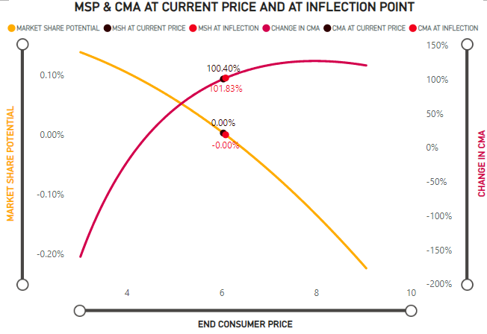
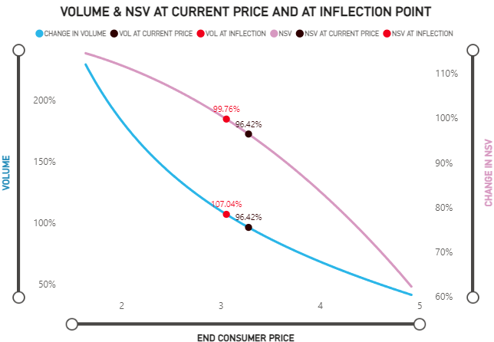
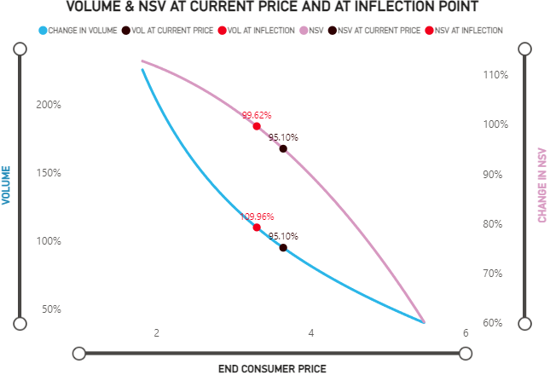
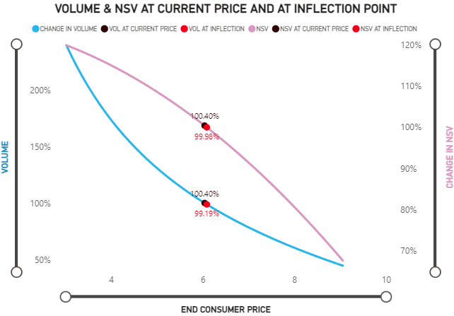
Food: Cut price in mayo & whipped dressing. Aioli can maintain its price
Mayo
Whipped Dressing
Aioli
Price- 3.06
RPI to Cat-90
Price- 3.28
RPI to Cat-96
Price- 3.30
RPI to Cat- 97
Price-3.64
RPI to Cat- 107
Price- 6.04
RPI to Cat- 177
Price- 6.09
RPI to Cat- 179

Slide 16
PPG Level - Food Channel - Market Context
Summary of change in market share and price across brands variants X PPG
Variant | Brand | PPG | Val. MS% | MS% Change | Avg Price | Price% Change
Mayo | Hellmanns | Jar 15Oz | 3.3% | 0.0% | 5.03 | 0.2%
Mayo | Kraft | Jar 15Oz | 0.3% | 0.0% | 5.01 | 3.0%
Mayo | Private Label | Jar 15Oz | 1.5% | 0.1% | 3.62 | -2.5%
Mayo | Dukes | Jar 30Oz | 5.5% | 0.7% | 2.51 | 2.2%
Mayo | Hellmanns | Jar 30Oz | 24.7% | -0.4% | 3.06 | 3.2%
Mayo | Kraft | Jar 30Oz | 5.0% | -0.6% | 2.7 | 2.2%
Mayo | Private Label | Jar 30Oz | 6.7% | 0.1% | 1.97 | -1.1%
Mayo | Hellmanns | Jar 48Oz | 3.1% | 0.1% | 2.95 | 0.4%
Mayo | Kraft | Jar 48Oz | 0.1% | 0.0% | 2.74 | 8.9%
Mayo | Hellmanns | Jar 8Oz | 1.0% | 0.0% | 7.83 | 6.3%
Mayo | Hellmanns | Other | 1.1% | 0.0% | 8.67 | 0.7%
Mayo | Kraft | Other | 0.1% | 0.0% | 2.24 | 12.7%
Mayo | Restofcategory | Other | 4.5% | 0.9% | 5.8 | -0.4%
Mayo | Hellmanns | Squeezy 12Oz | 3.9% | 0.2% | 6.67 | 5.5%
Mayo | Kraft | Squeezy 12Oz | 1.3% | -0.2% | 6.01 | 1.1%
Mayo | Dukes | Squeezy 18 To 22Oz | 2.2% | 0.3% | 4.08 | -2.2%
Mayo | Hellmanns | Squeezy 18 To 22Oz | 8.5% | 0.0% | 4.8 | 5.8%
Mayo | Kraft | Squeezy 18 To 22Oz | 2.1% | -0.4% | 4.01 | 0.0%
Mayo | Private Label | Squeezy 18 To 22Oz | 0.9% | -0.1% | 3.2 | 6.3%
Whipped Dressing | Miracle Whip | Jar 15Oz | 1.6% | 0.0% | 5.83 | -0.7%
Whipped Dressing | Miracle Whip | Jar 30Oz | 7.4% | -0.5% | 3.03 | 0.8%
Whipped Dressing | Miracle Whip | Jar 48Oz | 0.2% | -0.1% | 3.23 | 2.7%
Whipped Dressing | Miracle Whip | Squeezy 12Oz | 1.3% | -0.1% | 6.74 | 1.3%
Whipped Dressing | Miracle Whip | Squeezy 18 To 22Oz | 1.1% | -0.1% | 5.33 | -1.6%
Aioli | Mccormick Aioli | Jar 30Oz | 1.5% | 0.2% | 4.2 | 2.4%
70% of the total PPGs value is in jars
Within Jars, 30 Oz has the largest val. share at 53%
Squeezy bottles have 23% share in food and are relatively expensive than jars
Within Squeezy bottles, 18-22 Oz has a share of 16% and is declining across variants, possibly due to price increase in the range of 4.5%-8%
Almost all PPGs in Whipped Dressing are declining
Please note: All non-KHC PPGs contributing < 1% to the overall channel have been excluded from representation on the slides. For KHC brands, all PPG contributing more than 0.5% to the respective brands have been shown.

Slide 17
Food: Mayo & WD 30 Oz Jar face maximum risk and needs to cut price
Mayo
Whipped Dressing
Aioli
MCV
CSF
Price
C.MS
1.0% | 3.3% | 0.3% | 1.5% | 5.5% | 24.7% | 5.0% | 6.7% | 3.1% | 0.1% | 3.9% | 1.3% | 2.2% | 8.5% | 2.1% | 1.1% | 1.6% | 7.4% | 1.3% | 1.1% | 1.5% | 0.6% | 0.6%
0.01% | 0.25% | -0.02% | 0.01% | 0.05% | -0.25% | -0.35% | 0.01% | 0.01% | -0.01% | 0.28% | -0.01% | 0.02% | 0.16% | -0.02% | -0.28% | -0.11% | -0.36% | 0.02% | -0.10% | -0.08% | -0.01% | 0.01%
MSP
Kraft’s 30 Oz variant is facing the maximum risk of loss of share. Dukes in the same price range has a better CSF and a slightly better MCV. Similar competition from Hellman’s as well. This PPG requires price cut to protect loss of share
Kraft should consider expanding presence of Aioli in 30oz Jars – at a

Slide 18
Food: Mayo & WD cut in Jars; consider expanding Aioli to 30oz Jars
Channel | Variant | PPG | Brand | Current RPI Cat. | MCV RPI Cat. | Delta % | Vol. contr. to KHC
Food | Kraft | Mayo | Jar 15Oz | 147 | 132 | -9.8% | 1.1%
Food | Kraft | Mayo | Jar 30Oz | 79 | 72 | -9.5% | 30.5%
Food | Kraft | Mayo | Squeezy 12Oz | 176 | 175 | -0.7% | 3.7%
Food | Kraft | Mayo | Squeezy 18 To 22Oz | 118 | 117 | -0.4% | 8.8%
Food | Kraft | Aioli | Jar 30Oz |  | 78 | Suggested
Food | Kraft | Aioli | Squeezy 12Oz | 196 | 191 | -2.2% | 1.6%
Food | Miracle Whip | Whipped Dressing | Jar 15Oz | 171 | 153 | -10.6% | 4.5%
Food | Miracle Whip | Whipped Dressing | Jar 30Oz | 89 | 83 | -7.0% | 40.8%
Food | Miracle Whip | Whipped Dressing | Squeezy 12Oz | 198 | 202 | 2.2% | 3.1%
Food | Miracle Whip | Whipped Dressing | Squeezy 18 To 22Oz | 156 | 135 | -13.5% | 3.4%
Cut
Expand
Cut
Cut
Category is defined as Mayo + Aioli only

Slide 19
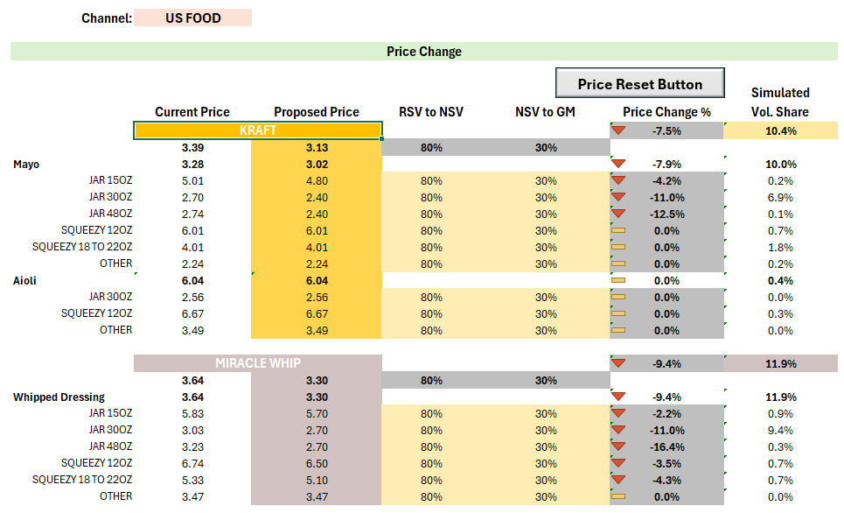
Recommendation:
Objective–
To minimize Market Share Loss for Kraft
Approach to reach Recommendation –
Kraft Mayo and Miracle Whip
Price reduction made where CSFs were low and PPG was at a risk of losing Market Share
Reduce prices of larger PPGs to price them lower than smaller PPGs
Kraft Aioli
Prices kept constant despite having a positive MSP to account for Volume Loss created by reduction in Kraft Mayo and Miracle Whip prices

Slide 20
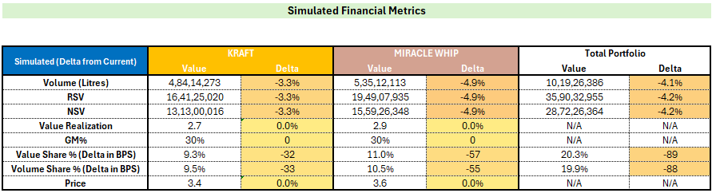
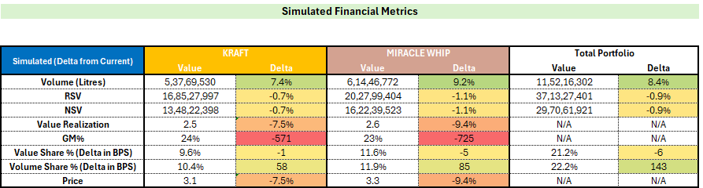
Impact of Recommendation:
Do Nothing Scenario
Based on Price Changes

Slide 21
Walmart

Slide 22
Variant x Brand -Walmart Channel - Market Context (Dec’23 to Nov’24 vs P12M )
Summary of change in market share and price across brands and variants
Brand | MS % | MS% Change | Avg Price | Price% Change
Dukes | 7.6% | 0.6% | 2.78 | 3.5%
Hellmanns | 37.4% | 0.8% | 3.46 | 6.2%
Kraft | 14.0% | -1.3% | 2.99 | 2.3%
Mccormick Aioli | 5.4% | 0.3% | 4.08 | 3.0%
Miracle Whip | 14.4% | -1.4% | 3.36 | -1.4%
Private Label | 13.0% | 0.9% | 1.95 | 2.9%
Restofcategory | 8.1% | 0.0% | 3.26 | 7.4%
Sales through Walmart : 31% Change in Category :
Value = +6.8%
Volume = +3.5%
Price = +3.1%
Unlike in other channels, here Mayo is gaining share, aioli is stable and whipped dressing continues to lose share
Although Mayo is growing, Kraft has lost max. share in both val. & vol. while in aioli, it has gained maximum share
Brand Variant | Val. MS% | MS% Change | Avg Price | Price% Change
Mayo | 76.4% | 1.2% | 2.90 | 3.9%
Dukes | 7.6% | 0.7% | 2.78 | 3.9%
Hellmanns | 37.1% | 0.7% | 3.45 | 6.1%
Kraft | 13.0% | -1.3% | 2.90 | 1.8%
Private Label | 13.0% | 0.9% | 1.95 | 2.9%
Restofcategory | 5.7% | 0.3% | 3.33 | 7.4%
Whipped Dressing | 15.9% | -1.4% | 3.22 | -0.2%
Miracle Whip | 14.4% | -1.4% | 3.36 | -1.4%
Restofcategory | 1.5% | 0.0% | 2.32 | 10.8%
Aioli | 7.7% | 0.2% | 4.51 | 3.2%
Hellmanns | 0.3% | 0.1% | 6.00 | 9.0%
Kraft | 1.0% | 0.0% | 5.53 | 5.4%
Private Label | 5.4% | 0.3% | 4.08 | 3.0%
Restofcategory | 1.0% | -0.2% | 6.84 | 9.9%

Slide 23
Walmart: Kraft is stronger in Aioli while facing risk in mayo & whipped dressing
While competition MCVs are ~5% lower in Walmart vs Food, Kraft’s are ~15% lower
Mayo- 70.7%
Whipped Dressing- 14.4%
Aioli- 6.7%
MCV
CSF
Price
C.MS
7.6% | 37.1% | 13.0% | 13.0% |  | 14.4% |  | 0.3% | 1.0% | 5.4%
0.25% | 0.55% | -0.53% | 0.55% |  | -0.78% |  | 0.00% | 0.04% | 0.15%
MSP
Dukes has better CSF and MCV at a price lower or same price as Kraft in Mayo. Kraft has risk of losing consumers to Dukes (if consumers are downgrading) and to Hellmanns (if consumers are upgrading)
Miracle Whip is overpriced and hence need to cut price in order to protect MS%
Kraft is strong in aioli and can maintain its current price

Slide 24
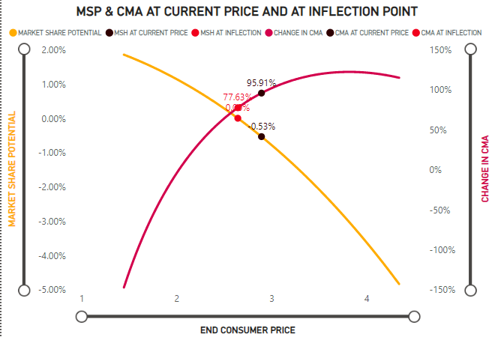
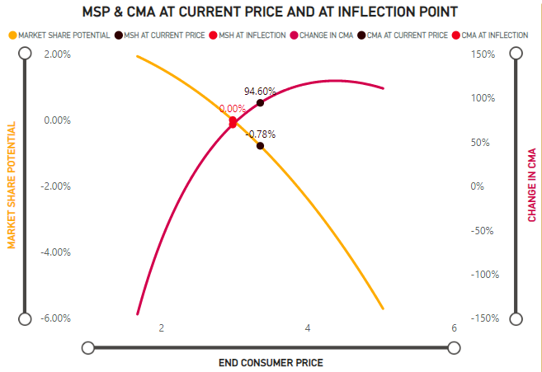
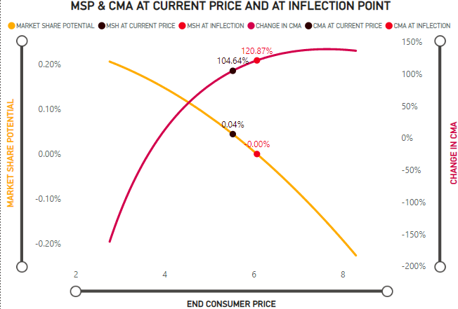
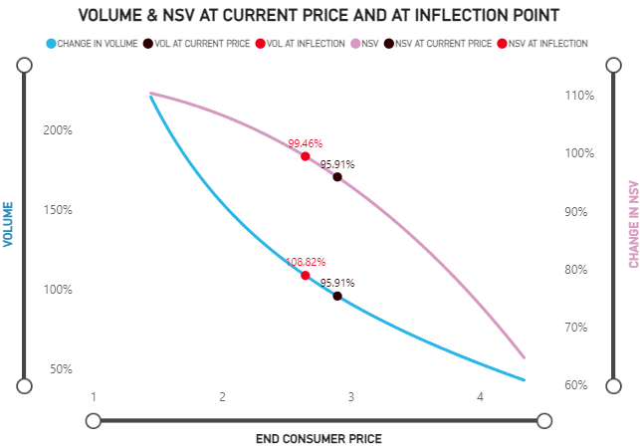
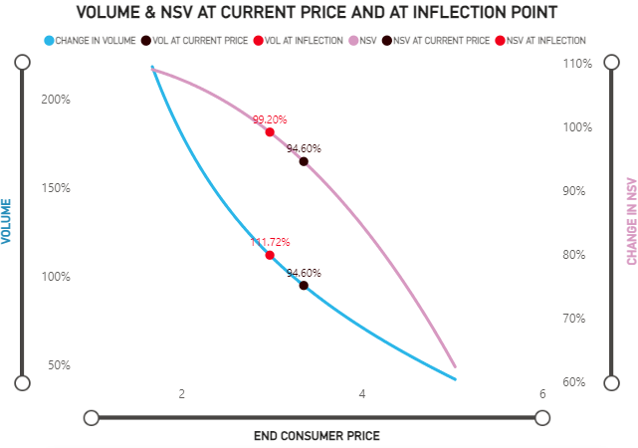
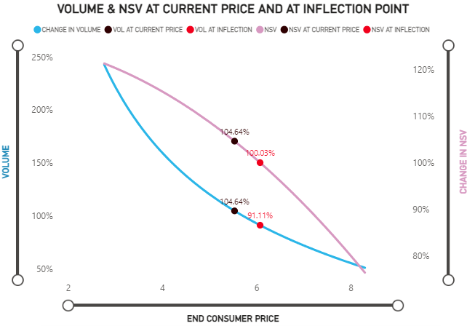
Walmart: Cut price in mayo & whipped dressing. Aioli can maintain its price
Mayo
Whipped Dressing
Aioli
Price- 2.65
RPI to Cat-89
Price- 2.90
RPI to Cat-98
Price- 2.98
RPI to Cat-100
Price-3.36
RPI to Cat-113
Price- 5.53
RPI to Cat-187
Price- 6.08
RPI to Cat-205

Slide 25
PPG Level - Walmart Channel - Market Context
Summary of change in market share and price across brands variants X PPG
Variant | Brand | PPG | Val. MS% | MS% Change | Avg Price | Price% Change
Aioli | Kraft | Squeezy 12Oz | 0.9% | 0.0% | 6.23 | 6.2%
Aioli | Mccormick Aioli | Jar 30Oz | 4.5% | 0.4% | 3.95 | 3.5%
Mayo | Hellmanns | Jar 15Oz | 3.1% | 0.4% | 4.24 | 0.1%
Mayo | Kraft | Jar 15Oz | 0.9% | 0.0% | 4.24 | 2.8%
Mayo | Private Label | Jar 15Oz | 1.8% | 0.2% | 2.26 | -5.3%
Mayo | Dukes | Jar 30Oz | 4.1% | 0.5% | 2.47 | 3.6%
Mayo | Hellmanns | Jar 30Oz | 19.0% | 0.3% | 3.00 | 5.9%
Mayo | Kraft | Jar 30Oz | 5.9% | -0.7% | 2.46 | -2.7%
Mayo | Private Label | Jar 30Oz | 7.1% | 0.4% | 1.81 | 2.2%
Mayo | Hellmanns | Jar 48Oz | 4.6% | -0.2% | 2.63 | 3.1%
Mayo | Kraft | Jar 48Oz | 1.3% | 0.0% | 2.6 | 6.2%
Mayo | Private Label | Jar 48Oz | 2.0% | 0.5% | 1.65 | 6.3%
Mayo | Hellmanns | Other | 1.2% | 0.3% | 8.54 | 7.6%
Mayo | Hellmanns | Squeezy 12Oz | 2.8% | -0.5% | 5.96 | 7.2%
Mayo | Kraft | Squeezy 12Oz | 1.5% | -0.1% | 5.3 | 2.4%
Mayo | Dukes | Squeezy 18 To 22Oz | 1.6% | 0.1% | 3.94 | 5.4%
Mayo | Hellmanns | Squeezy 18 To 22Oz | 6.5% | 0.3% | 4.71 | 7.4%
Mayo | Kraft | Squeezy 18 To 22Oz | 2.5% | -0.5% | 3.52 | 2.3%
Mayo | Private Label | Squeezy 18 To 22Oz | 2.1% | -0.2% | 2.96 | 16.7%
Whipped Dressing | Miracle Whip | Jar 15Oz | 1.9% | -0.2% | 5.04 | -2.0%
Whipped Dressing | Miracle Whip | Jar 30Oz | 7.8% | -0.6% | 2.83 | -1.9%
Whipped Dressing | Miracle Whip | Jar 48Oz | 1.2% | -0.2% | 2.84 | 1.8%
Whipped Dressing | Miracle Whip | Squeezy 12Oz | 1.5% | -0.2% | 6.3 | -2.0%
Whipped Dressing | Miracle Whip | Squeezy 18 To 22Oz | 1.8% | -0.2% | 4.46 | -2.0%
70% of the total PPGs are jars
Within Jars, 30 Oz has the largest val. share at 50%
Squeezy bottles have 23% share in food and are relatively expensive than jars
Within Squeezy bottles, 18-22 Oz has a share of 16% and is declining across variants, possibly due to price increase in the range of 10%-13%
Almost all PPGs in Whipped Dressing are declining
Please note: All non-KHC PPGs contributing < 1% to the overall channel have been excluded from representation on the slides. For KHC brands, all PPG contributing more than 0.5% to the respective brands have been shown.

Slide 26
Walmart- Mayo: Both 30oz Jar and 12oz Squeezy have poor MCVs
Mayo
Jar 15Oz- 5.8%
Jar 30Oz- 37.9%
Jar 48Oz- 29.3%
Sqz 12Oz- 4.3%
Sqz 18Oz-22Oz- 12.7%
Others- 5.2%
MCV
CSF
Price
C.MS
3.1% | 0.9% | 1.8% | 4.1% | 19.0% | 5.9% | 7.1% | 4.6% | 1.3% | 2.0% | 2.8% | 1.5% | 1.6% | 6.5% | 2.5% | 2.1% | 1.2% | 0.8%
0.33% | -0.10% | 0.41% | 0.11% | 0.27% | -0.41% | 0.17% | 0.21% | -0.20% | 0.05% | 0.07% | -0.16% | -0.01% | -0.04% | -0.07% | -0.05% | -0.30% | 0.41%
MSP
Kraft’s 30 Oz variant is facing the maximum risk of loss of share. Dukes in the same price range has a better CSF and MCV. Similar competition from Hellman’s as well. This PPG requires price cut to protect loss of share

Slide 27
Walmart- Miracle whip is overpriced across packs while Aioli has a strong CSF
Whipped Dressing
Aioli
MCV
CSF
Price
C.MS
1.9% | 7.8% | 1.2% | 1.5% | 1.8% | 4.5% | 0.9%
-0.21% | -0.34% | -0.13% | -0.16% | -0.12% | -0.06% | 0.02%
MSP
Need to cut price across Miracle Whip PPGs, more in 30 Oz.
Aioli can maintain price

Slide 28
Walmart: Mayo & WD cut in 30Oz Jars; consider expanding Aioli to 30oz Jars
Channel | Variant | PPG | Brand | Current RPI Cat. | MCV RPI Cat. | Delta % | Vol. contr. to KHC
Walmart | Kraft | Mayo | Jar 15Oz | 143 | 120 | -15.8% | 2.3%
Walmart | Kraft | Mayo | Jar 30Oz | 83 | 75 | -9.5% | 26.9%
Walmart | Kraft | Mayo | Jar 48Oz | 88 | 69 | -21.7% | 5.8%
Walmart | Kraft | Mayo | Squeezy 12Oz | 178 | 151 | -15.3% | 3.2%
Walmart | Kraft | Mayo | Squeezy 18 To 22Oz | 119 | 114 | -3.6% | 8.1%
Walmart | Kraft | Aioli | Jar 30Oz |  | 107 | Suggested
Walmart | Kraft | Aioli | Squeezy 12Oz | 210 | 217 | 3.3% | 1.5%
Walmart | Miracle Whip | Whipped Dressing | Jar 15Oz | 170 | 144 | -15.2% | 4.3%
Walmart | Miracle Whip | Whipped Dressing | Jar 30Oz | 95 | 90 | -5.7% | 30.7%
Walmart | Miracle Whip | Whipped Dressing | Jar 48Oz | 96 | 82 | -14.2% | 4.9%
Walmart | Miracle Whip | Whipped Dressing | Squeezy 12Oz | 212 | 181 | -14.7% | 2.6%
Walmart | Miracle Whip | Whipped Dressing | Squeezy 18 To 22Oz | 150 | 137 | -8.9% | 4.4%
Cut
Expand
Cut
Category is defined as Mayo + Aioli only

Slide 29
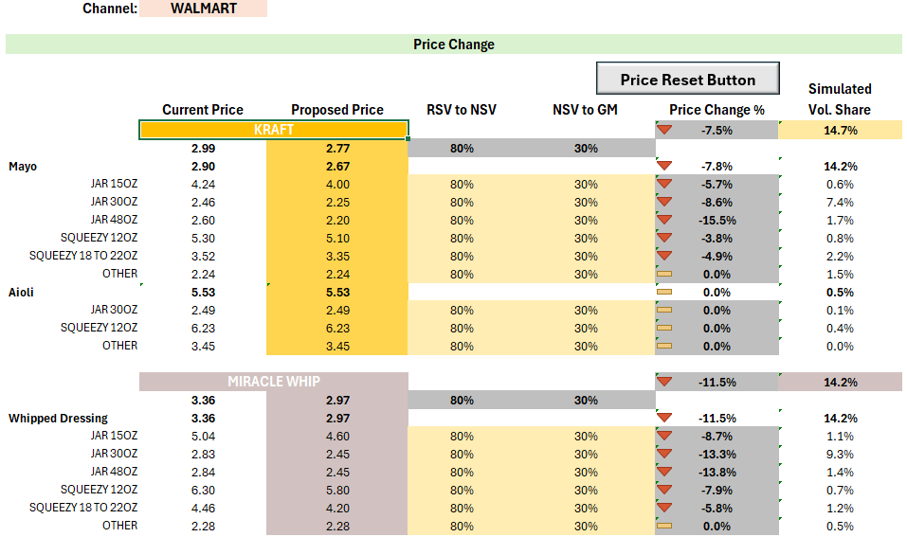
Recommendation:
Objective–
To minimize Market Share Loss for Kraft
Approach to reach Recommendation –
Kraft Mayo and Miracle Whip
Price reduction made where CSFs were low and PPG was at a risk of losing Market Share
Reduce prices of larger PPGs to price them lower than smaller PPGs
Kraft Aioli
Prices kept constant despite having a positive MSP to account for Volume Loss created by reduction in Kraft Mayo and Miracle Whip prices

Slide 30
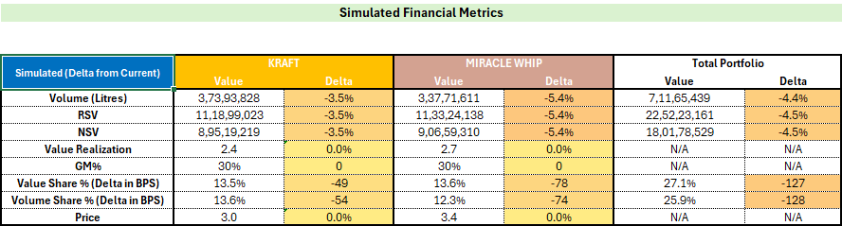
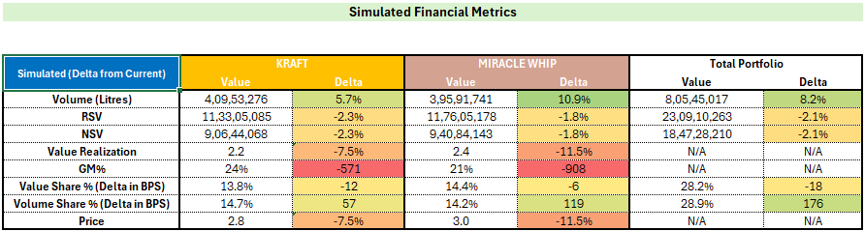
Impact of Recommendation:
Do Nothing Scenario
Based on Price Changes

Slide 31
Target

Slide 32
Variant x Brand -Target Channel - Market Context (Dec’23 to Nov’24 vs P12M )
Summary of change in market share and price across brands and variants
Brand | Val. MS % | MS% Change | Avg Price | Price% Change
Dukes | 2.8% | -0.2% | 3.21 | 6.5%
Hellmanns | 54.4% | -1.5% | 4.16 | 9.3%
Kraft | 10.6% | 0.3% | 3.76 | 8.4%
Miracle Whip | 6.7% | -0.6% | 3.75 | -1.1%
Private Label | 8.1% | -0.7% | 2.22 | -9.9%
Restofcategory | 17.4% | 2.7% | 6.68 | 5.6%
Sales through Target: 3% Change in Category :
Value = +5.6%
Volume = -1.1%
Price = +6.7%
Both Mayo & Whipped Dressing are losing share to Aioli in value and volume
Almost all brands have lost share in Mayo
In Aioli, Kraft has gained the maximum share
Brand Variant | Val. MS% | MS% Change | Avg Price | Price% Change
Mayo | 84.2% | -0.8% | 3.89 | 6.8%
Dukes | 2.8% | -0.2% | 3.21 | 6.5%
Hellmanns | 52.6% | -2.2% | 4.11 | 8.7%
Kraft | 6.7% | -0.9% | 3.13 | 1.5%
Private Label | 8.0% | -0.1% | 2.19 | -4.8%
Restofcategory | 14.1% | 2.6% | 6.46 | 4.6%
Whipped Dressing | 6.7% | -0.6% | 3.75 | -1.1%
Miracle Whip | 6.7% | -0.6% | 3.75 | -1.1%
Aioli | 9.1% | 1.3% | 6.55 | 5.4%
Hellmanns | 1.8% | 0.7% | 6.36 | 10.3%
Kraft | 3.9% | 1.2% | 5.76 | 9.2%
Private Label | 0.1% | -0.7% | 9.64 | 9.7%
Restofcategory | 3.3% | 0.1% | 7.80 | 13.0%

Slide 33
Kraft is strong in Aioli in both CSF & MCV. In mayo, it faces risk from Dukes
The best CSF is offered by Premium brands sitting in ‘Rest of Category’
Mayo- 70.1%
Whipped Dressing- 6.7%
Aioli- 5.6%
MCV
CSF
Price
C.MS
2.8% | 52.6% | 6.7% | 8.0% |  | 6.7% |  | 1.8% | 3.9%
-0.06% | -0.36% | -0.27% | -0.01% |  | -0.19% |  | 0.04% | 0.15%
MSP
Kraft has a lower MCV than Dukes but a comparable CSF. There is a risk of loss of share and Kraft should decrease price in Mayo
Whipped Dressing is losing here as well but has lesser threat of further decline than in Food due to better CSF. However, it needs price cut
Kraft is aioli has a strong position both in terms of CSF and MCV. It should continue to hold price to gain from losses in other variants

Slide 34
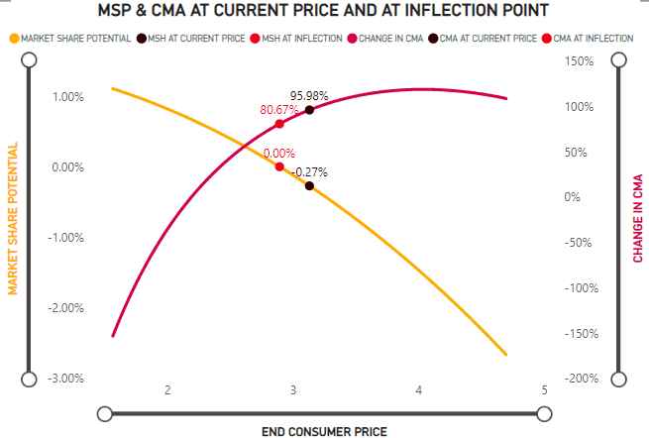
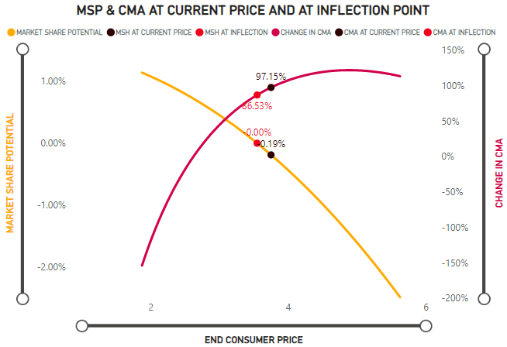
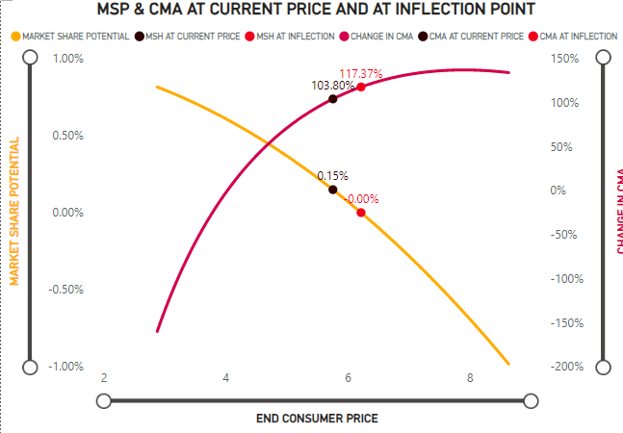
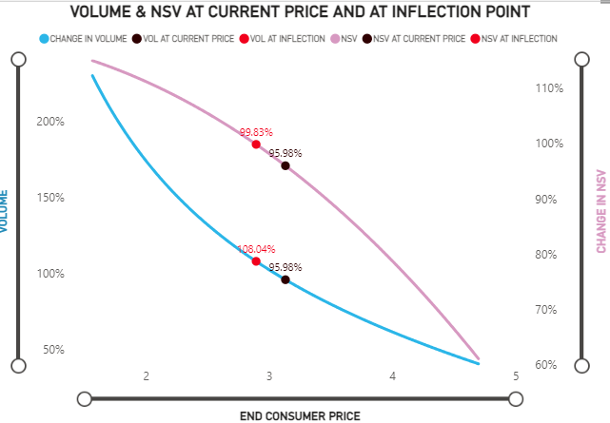
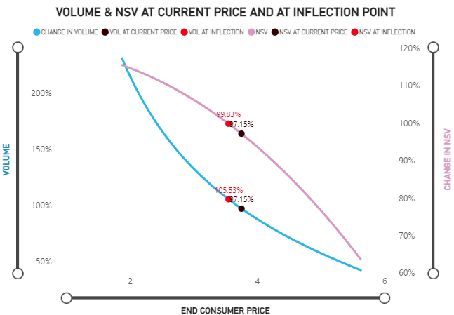
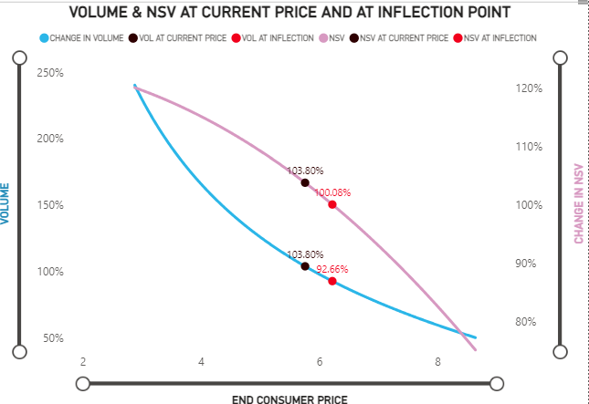
Target: Cut price in mayo & whipped dressing. Aioli can maintain its price
Mayo
Whipped Dressing
Aioli
Price- 2.89
RPI to Cat-73
Price- 3.13
RPI to Cat-79
Price- 3.55
RPI to Cat-90
Price- 3.75
RPI to Cat-95
Price- 5.76
RPI to Cat-146
Price- 6.22
RPI to Cat-157

Slide 35
PPG Level - Target Channel - Market Context
Summary of change in market share and price across brands variants X PPG
Variant | Brand | PPG | Val. MS% | MS% Change | Avg Price | Price% Change
Mayo | Hellmanns | Jar 15Oz | 4.4% | 0.3% | 4.51 | 3.2%
Mayo | Private Label | Jar 15Oz | 0.8% | 0.1% | 5.11 | 0.2%
Mayo | Dukes | Jar 30Oz | 1.4% | -0.1% | 2.52 | 3.4%
Mayo | Hellmanns | Jar 30Oz | 19.4% | -1.9% | 3.06 | 7.3%
Mayo | Kraft | Jar 30Oz | 4.0% | -0.4% | 2.62 | 3.1%
Mayo | Private Label | Jar 30Oz | 4.4% | 0.4% | 1.83 | -2.1%
Mayo | Hellmanns | Squeezy 12Oz | 7.2% | 0.6% | 6.34 | 5.3%
Mayo | Kraft | Squeezy 12Oz | 1.6% | -0.4% | 5.38 | -3.4%
Mayo | Dukes | Squeezy 18 To 22Oz | 1.1% | -0.3% | 4.04 | 7.2%
Mayo | Hellmanns | Squeezy 18 To 22Oz | 17.4% | -0.3% | 4.61 | 7.1%
Mayo | Kraft | Squeezy 18 To 22Oz | 1.1% | 0.0% | 3.58 | 7.2%
Mayo | Private Label | Squeezy 18 To 22Oz | 1.0% | -2.3% | 2.19 | -24.8%
Mayo | Hellmanns | Other | 3.8% | -0.6% | 9.25 | 9.9%
Mayo | Private Label | Other | 1.8% | 1.8% | 2.85 | -
Whipped Dressing | Miracle Whip | Jar 15Oz | 0.7% | 0.3% | 5.25 | -0.1%
Whipped Dressing | Miracle Whip | Jar 30Oz | 3.7% | -0.5% | 2.93 | -2.6%
Whipped Dressing | Miracle Whip | Squeezy 12Oz | 2.2% | 0.1% | 6.05 | -10.4%
Aioli | Kraft | Squeezy 12Oz | 3.7% | 1.4% | 5.99 | 3.0%
Aioli | Restofcategory | Squeezy 18 To 22Oz | 2.6% | 0.0% | 7.42 | 13.2%
Aioli | Hellmanns | Other | 1.8% | 0.7% | 6.36 | 9.3%
Jars have only 43% value share in Target whereas, Squeezy bottles have 38% share
Within jars, 30 Oz continue to have bigger share while in squeezy, 18-22 Oz continue to have a larger share
Here too, 18-22 Oz squeezy is declining across variants
Please note: All PPGs contributing < 0.5% to the overall channel have been excluded from representation.

Slide 36
Target: Mayo & WD 30 Oz jar has risk due to lower CSF
Mayo
Whipped Dressing
Aioli
MCV
CSF
Price
C.MS
4.4% | 0.8% | 1.4% | 19.4% | 4.0% | 4.4% | 7.2% | 1.6% | 1.1% | 17.4% | 1.1% | 1.0% | 3.8% | 1.8% | 0.7% | 3.7% | 2.2% | 3.7% | 1.8%
0.85% | -0.22% | -0.01% | -0.23% | -0.21% | -0.36% | 0.01% | -0.05% | -0.08% | -0.56% | -0.01% | 0.05% | -0.48% | 0.51% | 0.01% | -0.15% | -0.05% | 0.04% | 0.04%
MSP
30 Oz jar needs slight price reduction to protect loss of share

Slide 37
Target: Mayo & WD cut in 30Oz Jars; consider expanding Aioli to 30oz Jars
Channel | Variant | PPG | Brand | Current RPI Cat. | MCV RPI Cat. | Delta % | Vol. Share
Target | Kraft | Mayo | Jar 30Oz | 66 | 61 | -7.2% | 33.5%
Target | Kraft | Mayo | Squeezy 12Oz | 136 | 130 | -4.6% | 6.3%
Target | Kraft | Mayo | Squeezy 18 To 22Oz | 91 | 90 | -0.9% | 6.8%
Target | Kraft | Aioli | Jar 30Oz |  | 73 | Suggested
Target | Kraft | Aioli | Squeezy 12Oz | 152 | 155 | 2.0% | 13.6%
Target | Miracle Whip | Whipped Dressing | Jar 15Oz | 133 | 135 | 1.5% | 3.0%
Target | Miracle Whip | Whipped Dressing | Jar 30Oz | 74 | 70 | -5.4% | 27.8%
Target | Miracle Whip | Whipped Dressing | Squeezy 12Oz | 153 | 148 | -3.0% | 7.9%
Cut
Expand
Cut
Category is defined as Mayo + Aioli only

Slide 38
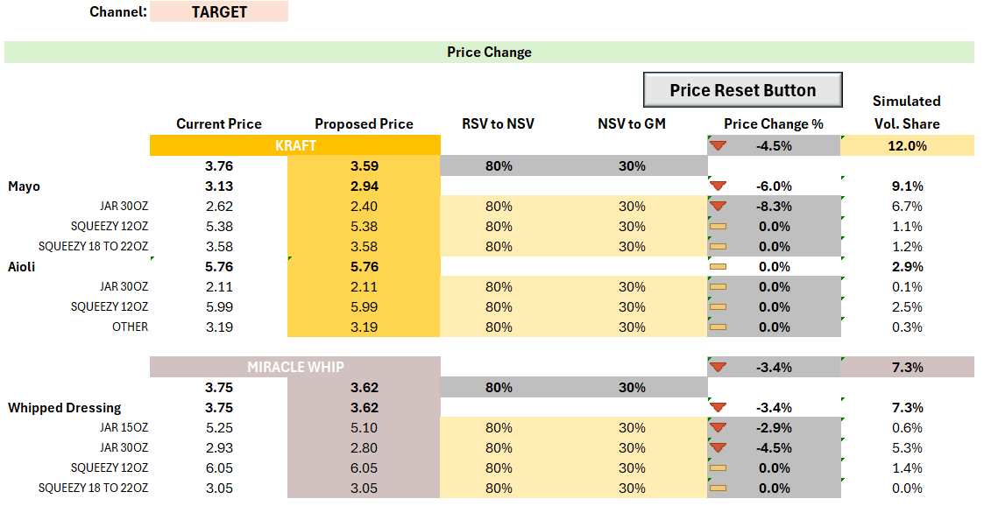
Recommendation:
Objective–
To minimize Market Share Loss for Kraft
Approach to reach Recommendation –
Kraft Mayo and Miracle Whip
Price reduction made where CSFs were low and PPG was at a risk of losing Market Share
Reduce prices of larger PPGs to price them lower than smaller PPGs
Kraft Aioli
Prices kept constant despite having a positive MSP to account for Volume Loss created by reduction in Kraft Mayo and Miracle Whip prices

Slide 39

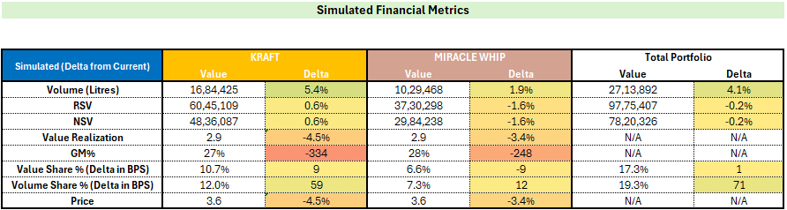
Impact of Recommendation:
Do Nothing Scenario
Based on Price Changes

Slide 40
Thank You

